Slide 1
HOW TO MAKE A WEBSITE
PRESENTED BY JAY MO & SU MIN

Slide 2
HI, I’M JAY MO
INTRODUCTION
HOW TO MAKE A WEBSITE
And I’m a web developer

Slide 3
I’M SU MIN
INTRODUCTION
HOW TO MAKE A WEBSITE
And I’m also a web developer

Slide 4
WHAT YOU’LL NEED
INTRODUCTION
HOW TO MAKE A WEBSITE
Some text editor (Brackets, Sublime Text, Atom)
Internet connection
Positive attitude (optional, but highly preferred)

Slide 5
GO TO JAYMO.ME/CDNJ
INTRODUCTION
HOW TO MAKE A WEBSITE
CLONE OR DOWNLOAD THE FILES

Slide 6
AGENDA

Slide 7
HTML5
CSS3
Bootstrap
JavaScript
Deploy

Slide 8
HTML5
STRUCTURE OF YOUR WEBSITE

Slide 9
HTML5: OVERVIEW
BASICS AND BACKGROUND ON HTML5

Slide 10
WHAT IS HTML5?
HTML5: OVERVIEW
HOW TO MAKE A WEBSITE

Slide 11
WHAT IS HTML5?
HTML5: OVERVIEW
HOW TO MAKE A WEBSITE
Stands for HYPER TEXT MARKUP LANGUAGE
Very commonly used to build websites
Consisted of tags

Slide 12
WHAT ARE TAGS?
HTML5: OVERVIEW
HOW TO MAKE A WEBSITE
Keywords that define how it’s formatted and displayed
Looks like <tag>
Must close with </tag> if multi-line

Slide 13
GO TO JAYMO.ME/CDNJ
HTML5: OVERVIEW
HOW TO MAKE A WEBSITE
CLONE OR DOWNLOAD THE FILES

Slide 14
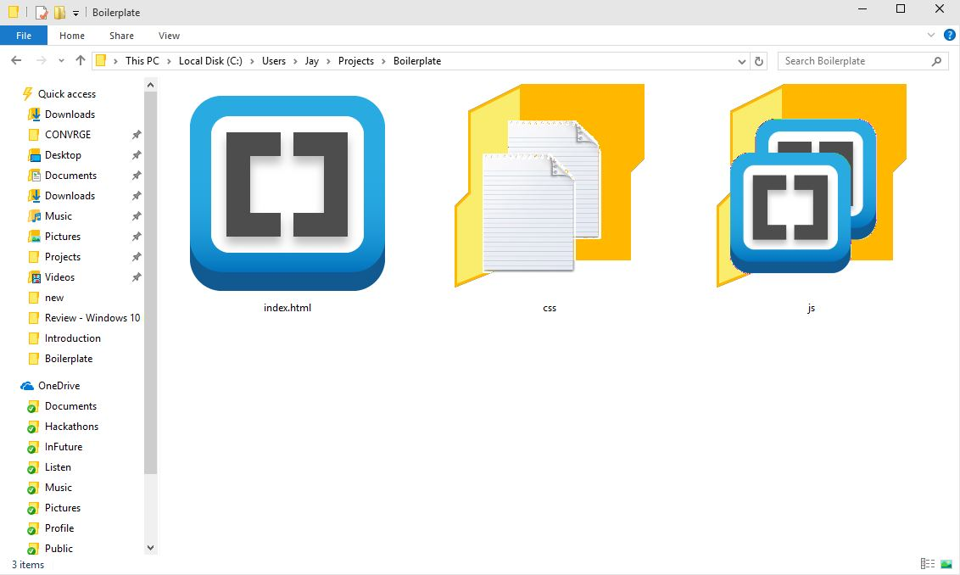
HERE ARE THE FILES
HTML5: OVERVIEW
HOW TO MAKE A WEBSITE

Slide 15
FILE STRUCTURE
HTML5: OVERVIEW
HOW TO MAKE A WEBSITE
<!DOCTYPE html> Declaration tag
<html> Encloses the document
<head> Represents the header
<title> Title of document
<body> Represents the content

Slide 16
HTML5: USEFUL TAGS
THE POPULAR ONES YOU’LL NEED

Slide 17
HEADING
HTML5: USEFUL TAGS
HOW TO MAKE A WEBSITE
<h1>This is for big titles</h1>
<h2>This is for section titles</h2>
<h3>This is small</h3>
<h4>This is really small</h4>
<h5>This is really really small</h5>
<h6>This is really really really small</h6>

Slide 18
PARAGRAPH
HTML5: USEFUL TAGS
HOW TO MAKE A WEBSITE
<p>This is used for long text</p>
<i>italics</i>
<b>bold</b>
<br>

Slide 19
LIST
HTML5: USEFUL TAGS
HOW TO MAKE A WEBSITE
<ul> Specifies an unordered list
<li> List item
<ul>
<li>Item 1</li>
<li>Item 2</li>
</ul>

Slide 20
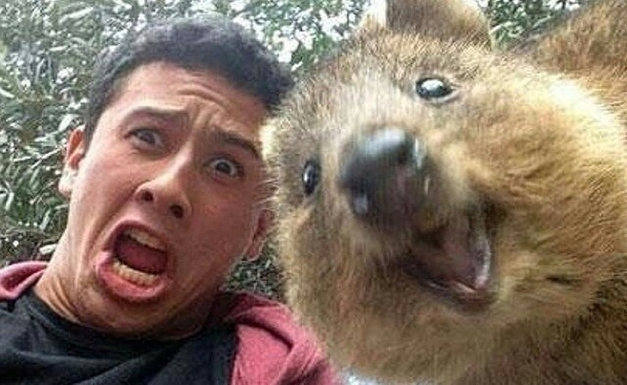
IMAGES
HTML5: USEFUL TAGS
HOW TO MAKE A WEBSITE
<img src=“quokka.jpg”>

Slide 21
LAYOUT
HTML5: USEFUL TAGS
HOW TO MAKE A WEBSITE
<div> Div
<section> Section
<header> Header
<article> Article
<footer> Footer

Slide 22
FORMS & BUTTONS
HTML5: USEFUL TAGS
HOW TO MAKE A WEBSITE
<input> Input
<button> Button
<form> Form

Slide 23
MISCELLANEOUS
HTML5: USEFUL TAGS
HOW TO MAKE A WEBSITE
<a> Links
<link> Import styling
<script> Import script (JS)

Slide 24
HTML5: ATTRIBUTES
ATTRIBUTES ARE BASICALLY TRAITS OR PROPERTIES

Slide 25
WHAT ARE ATTRIBUTES?
HTML5: ATTRIBUTES
HOW TO MAKE A WEBSITE
Attributes provide additional information
i.e. <p id=“attribute”>#hellyeah</p>

Slide 26
COMMON ATTRIBUTES
HTML5: ATTRIBUTES
HOW TO MAKE A WEBSITE
ID Specify an identifier
CLASS Specify a group
STYLE Style the element
ONEVENT Triggers on event

Slide 27
SPECIAL ATTRIBUTES
HTML5: ATTRIBUTES
HOW TO MAKE A WEBSITE
<a href=“link”> Link to something
<img src=“file”> Pulls data from file

Slide 28
CSS3
MAKE YOUR WEBSITE BEAUTIFUL

Slide 29
WHAT IS CSS3?
CSS3: OVERVIEW
HOW TO MAKE A WEBSITE

Slide 30
WHAT IS CSS3?
CSS3: OVERVIEW
HOW TO MAKE A WEBSITE
It’s like makeup for your HTML
Very commonly used to build websites
Consisted of properties and attributes

Slide 31
CSS3: SYNTAX
FILLER TEXT RIGHT HERE THIS FONT IS BEAUT

Slide 32
SYNTAX
CSS3: SYNTAX
HOW TO MAKE A WEBSITE
Target: element, class, id
Consisted of properties and attributes
target {
property: attribute;
}

Slide 33
SELECTORS
CSS3: SELECTORS
HOW TO MAKE A WEBSITE
p { /* HTML elements */ }
.class { /* Class elements */ }
#id { /* ID elements */ }

Slide 34
EXAMPLE
CSS3: EXAMPLE
HOW TO MAKE A WEBSITE
.really-pretty {
color: blue;
margin: 1px 2px 3px 4px;
/* top right bottom left */
border: 1px solid black;
}

Slide 35
COMMON PROPERTIES
CSS3: SELECTORS
HOW TO MAKE A WEBSITE
width width of element
height height of element
margin margin
padding inner padding
border border of element

Slide 36
COMMON PROPERTIES
CSS3: PROPERTIES
HOW TO MAKE A WEBSITE
color specifies the color of text
background-color background color
font-family font (Arial, TMS)
font-size font size (px, %, em, rem)
text-align align to left, center, right

Slide 37
BOOTSTRAP
DOING THIS EFFICIENTLY

Slide 38
WHAT IS BOOTSTRAP?
BOOTSTRAP: OVERVIEW
HOW TO MAKE A WEBSITE

Slide 39
WHAT IS BOOTSTRAP?
BOOTSTRAP: OVERVIEW
HOW TO MAKE A WEBSITE
One of the most popular web frameworks
Helps you build websites quickly
Easy tool for responsive website

Slide 40
GETBOOTSTRAP.COM
It’s already included in your boilerplate

Slide 41
COMMON USAGE
BOOTSTRAP: COMON USAGE
HOW TO MAKE A WEBSITE
grid
panels
form
text helpers
buttons
other stupid classes
popup
popup
navbar
navbar

Slide 42
JAVASCRIPT
MAKE YOUR WEBSITE FUN

